Slide 1
L.A. Crimes
What factors can help distinguish between different types of crime?
Shrusti Jain, Kevin Lu, Taobo Liao, Smeet Patel
Notes:
smeet

Slide 2

Roadmap
1
2
3
Motivation
Technical Details
Conclusions
Notes:
Smeet

Slide 3

Motivation
Understand distinguishing features of different crimes
Feature importance in predicting between crimes
Part 1 vs Part 2 (more serious vs less serious) crimes
Train on subsets based on date
Shrusti Jain, Smeet Patel
Notes:
Smeet

Slide 4




Overview
Sample Data
Baseline
Deep Learning
Feature Importance
Discussing the features and challenges
Do we need deep learning?
Technical challenges and experiments.
Drawing conclusions.
Shrusti Jain, Kevin Lu, Taobo Liao, Smeet Patel
Notes:
Smeet

Slide 5
Sample Data
Notes:
Kevin

Slide 6
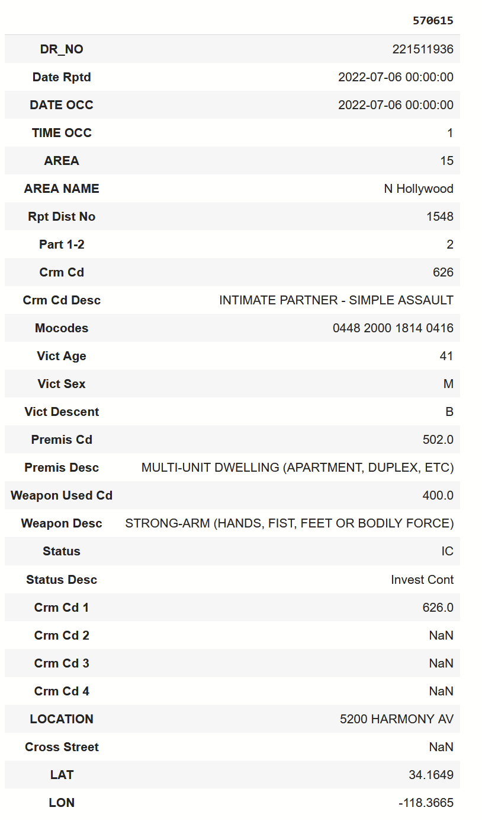
Raw Sample Example
Shrusti Jain, Smeet Patel, Kevin Lu
Notes:
Kevin

Slide 7
Features
Label:
Type of crime
Crime severity (part 1 or 2)
Input features
Date Occurred
Time Occurred
Victim Age
Victim Sex
Victim Descent
Mocodes
Area
Premise Code
District Number
Status
Weapon Involved Code
Shrusti Jain, Kevin Lu, Taobo Liao, Smeet Patel
Notes:
Kevin

Slide 8
Missing Data
Multiple features had either null values or values of 0
When there was no human victim, victim age would be 0 equivalent to null
Skewed the training data
Premise code had null values
Null values were not removed but encoded specially
Kevin Lu, Taobo Liao, Smeet Patel
Notes:
Kevin

Slide 9
Feature Conversion
Input features described the situation or environment, output features described the crime
Categorical features were one-hot encoded
e.g. victim sex, victim descent
Numerical codes with no numerical relationship were one-hot encoded
e.g. Mocodes, area code
Label is one-hot encoded for the same reason
Kevin Lu, Smeet Patel
Notes:
Kevin

Slide 10
Data Imbalance
Mocodes was heavily skewed towards most common codes
Cut down to codes with above 2000 occurrences to avoid imbalance
Also ran into RAM issues with such a large feature set
738 codes -> 138 codes
Crime codes had a similar issue
Grouped together low frequency codes into one “other category”
Loss was weighted based on frequency of each code
Shrusti Jain, Kevin Lu
Notes:
Kevin

Slide 11
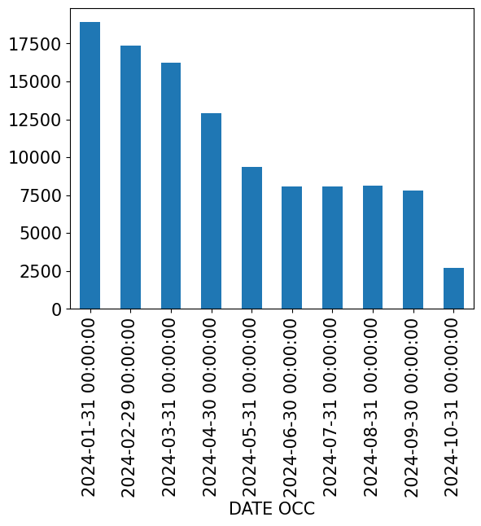
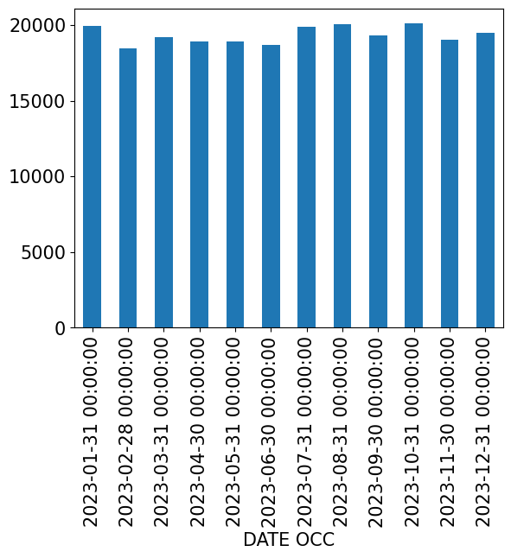
Time Imbalance
2024 had a severe lack of data compared to years 2020-2023
Refer to slide 23 for feature importance of date occurred
Shrusti Jain, Kevin Lu
Notes:
Kevin

Slide 12
Baseline Learning
Notes:
Will

Slide 13
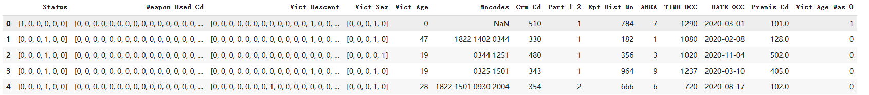
Baseline Learning
Sample data points (with one-hot encoding)
Kevin Lu, Taobo Liao, Smeet Patel
Notes:
Will

Slide 14
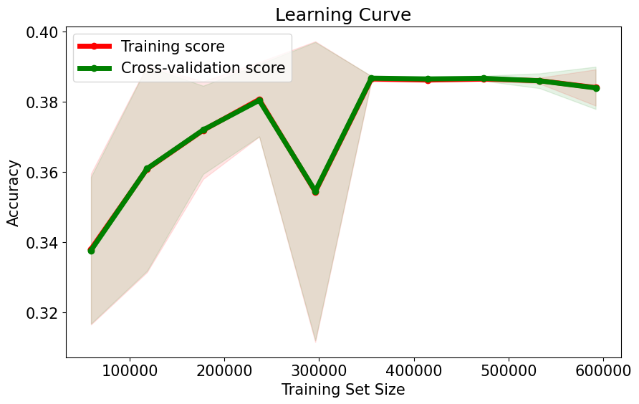
Baseline Learning Result
Linear classifier
Reached about 39% accuracy
Shrusti Jain, Taobo Liao, Smeet Patel
Notes:
Will

Slide 15
Deep Learning
Notes:
Smeet

Slide 16
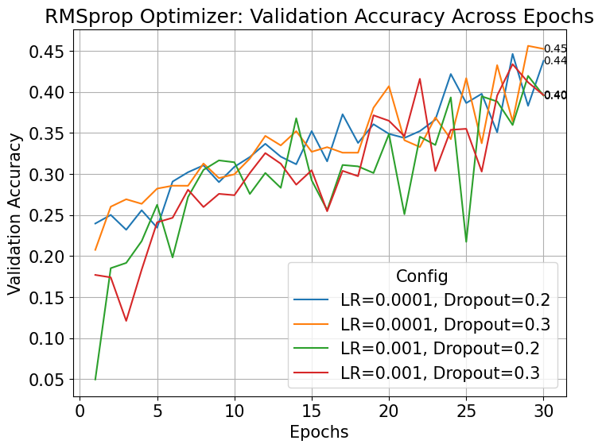
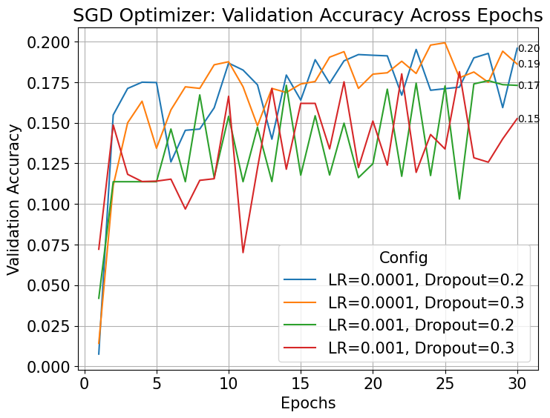
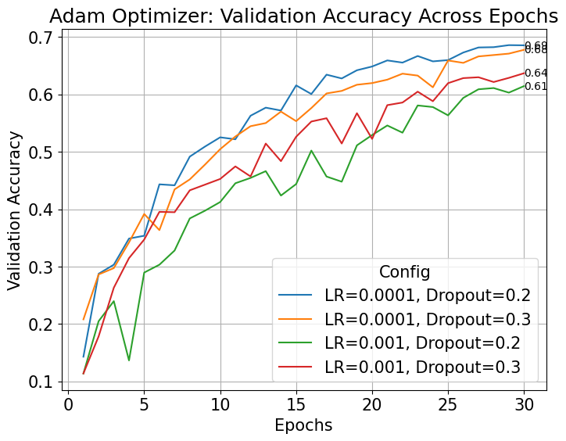
Best optimizer and tuning hyper-parameters
Smeet Patel
Notes:
smeet

Slide 17
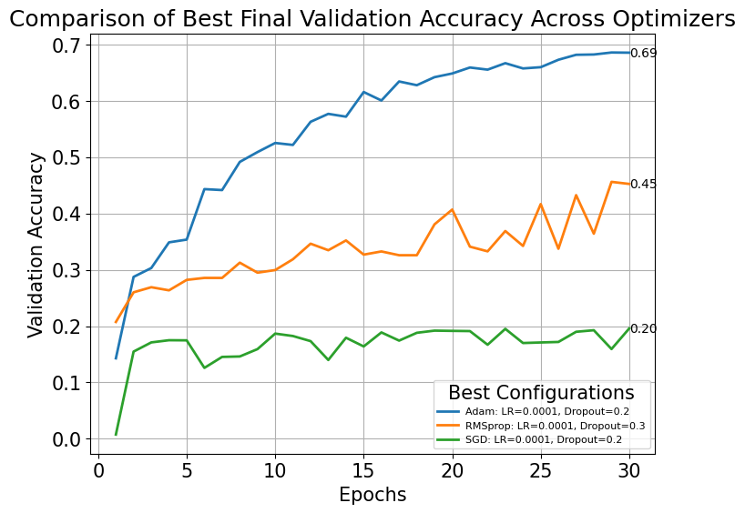
Comparison of different optimizers
Smeet Patel
Notes:
smeet

Slide 18
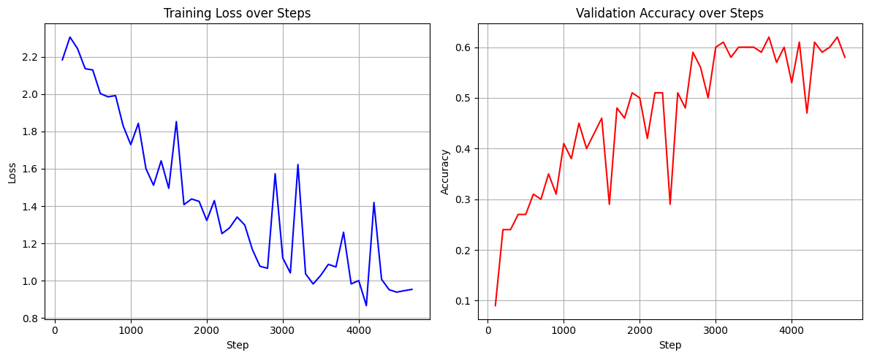
Deep Learning
Results
Taobo Liao, Smeet Patel, Kevin Lu
Notes:
smeet

Slide 19
Feature Importance
Notes:
Will

Slide 20
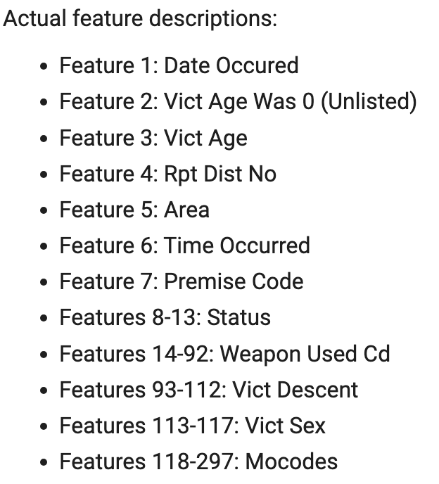
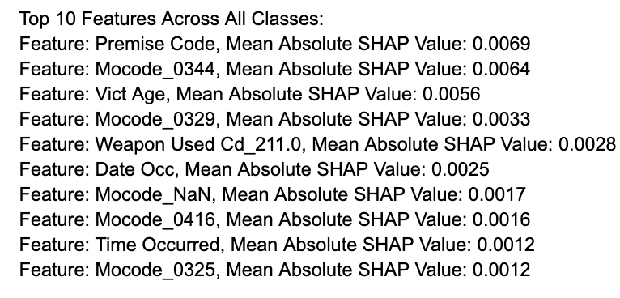
Per Feature Importance Results
Top 10 most important features
Single type features (features with one column) contribute more to the predictions.
Some features in Mocodes (feature 118-297) are still important even though Mocodes include 180 different types of features.
Shrusti Jain, Kevin Lu, Taobo Liao, Smeet Patel
Notes:
will

Slide 21
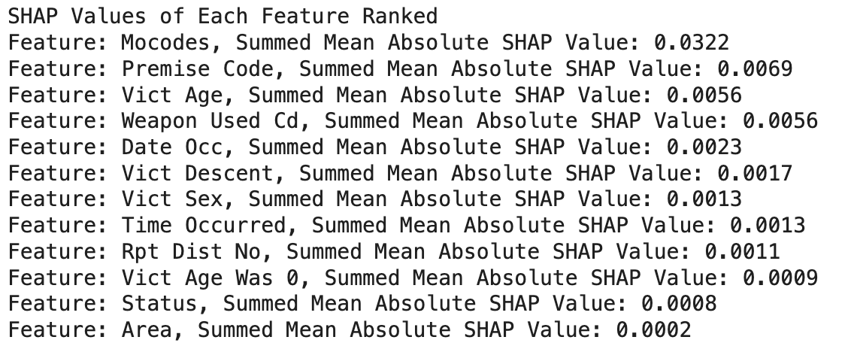
Grouped Feature Importance Results
Rankings of feature importance per group
groups are comprised of their respective one-hot encodings
results are a summation of Shapley values
Shrusti Jain, Kevin Lu, Taobo Liao, Smeet Patel
Notes:
will

Slide 22
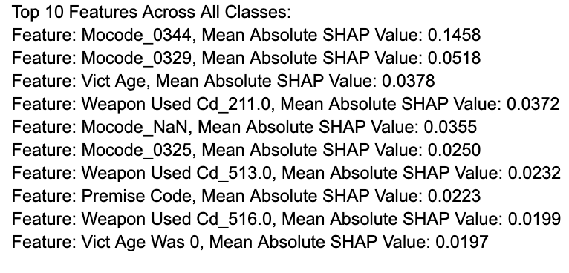
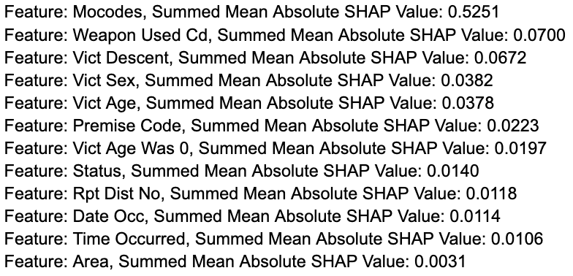
Part 1-2
What is Part 1 or 2 crime?
Training with Part 1 or 2 crime as target
Accuracy: .93 on test set
Feature Importance
Shrusti Jain
Notes:
shrusti

Slide 23
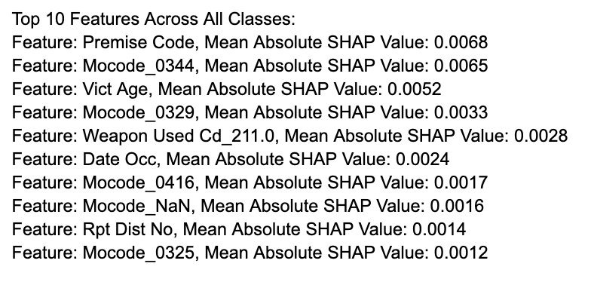
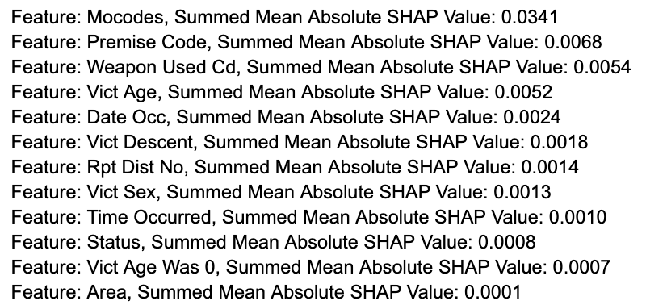
Time-Sensitive Learning
Training on 2020-2022 data, “validating” on 2023, testing on 2024
Accuracy: .62 on 2023, .46 on 2024
Data bias
Feature Importance
Data points per month in 2024
Data points per month in 2023
Shrusti Jain
Notes:
shrusti

Slide 24
Conclusions
Notes:
Shrusti

Slide 25
Conclusion (Features/Results)
Baseline learning showed that deep learning was necessary for accuracy predictions
39% accuracy vs Deep Learning 68% accuracy
Mocodes, descriptors of the suspect, are by far the most important features in prediction
Is also the largest group of features
Per feature importance shows that Premise Code, Victim Age, Date/Time occured are most important
Shrusti Jain, Kevin Lu, Taobo Liao, Smeet Patel
Notes:
shrusti

Slide 26
Conclusion (Implications)
Authorities can allocate resources in real-time
Addressing factors that predict crime severity
Adaptively adjust resources based on more probable crimes
Shrusti Jain, Kevin Lu, Taobo Liao, Smeet Patel
Notes:
shrusti

Slide 27
Conclusion (Restrictions)
Limited dataset
Features available
Feature imbalance
Time imbalance
Only includes information when crime occurs
Limited GPU usage and RAM availability
Shrusti Jain, Kevin Lu
Notes:
shrusti

Slide 28
Conclusion (Future Work)
Cross referencing with other datasets
Weather, income, unemployment rates, traffic
Including data where crime doesn’t happen
Stronger GPU and more RAM
Expanding the model to an RNN
Predict evolution of crime over a time-period
Real-time predictions
Leveraging modern IoT systems
Shrusti Jain, Kevin Lu
Notes:
shrusti

Slide 29
Thank you!
Notes:
Shrusti

